Slide 1

Form16 Digital Signature validation
APJ – India Payroll

Slide 2
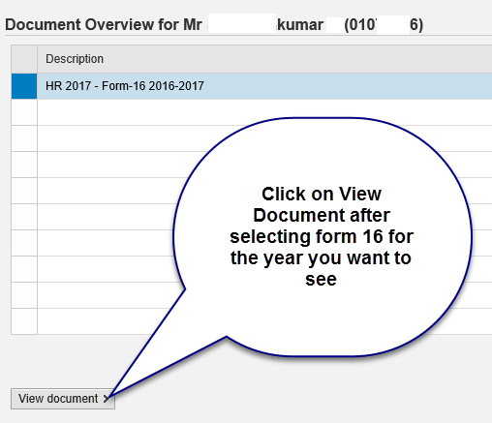
> You need to click on view document once you land on the form 16 page. > Select the Form 16 you would like to view

Slide 3
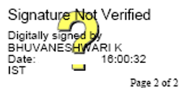
Form16 Certification signature need to be changed by clicking on Digital Signature below
Click on Digital Signature from your Form16

Slide 4
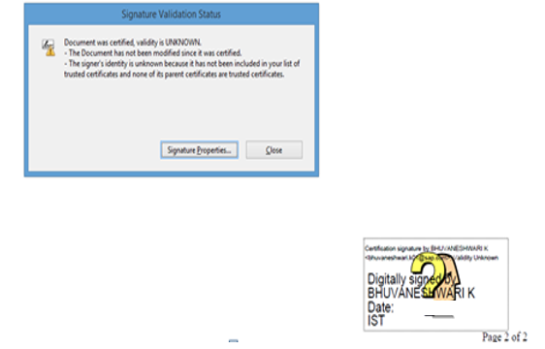
Select Signature properties radio button

Slide 5
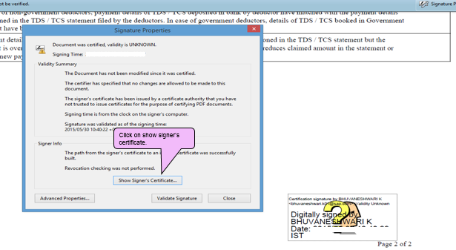
Select Show Certificate radio button

Slide 6
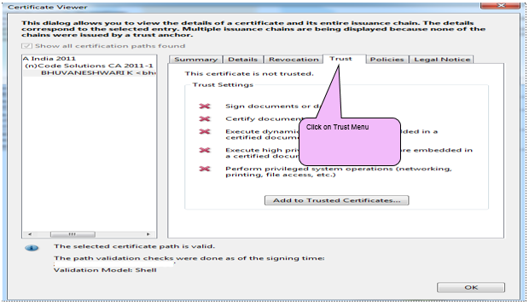
Select Trust menu

Slide 7
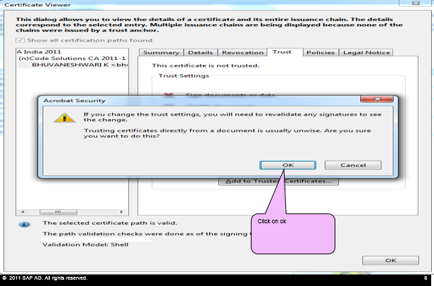
Select Add to Trusted Identities radio button & click ok

Slide 8
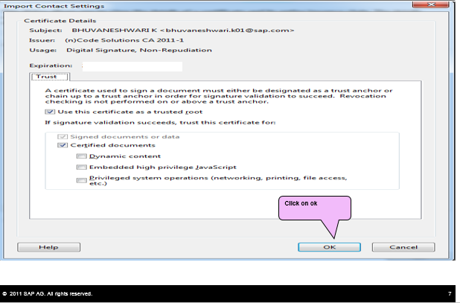
Import contact setting click ok radio button

Slide 9
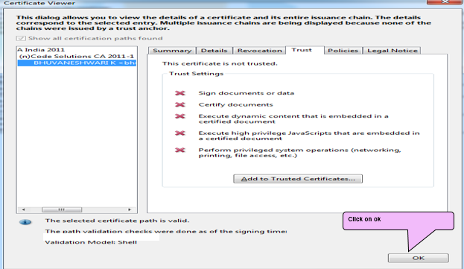
Certificate Viewer click ok radio button

Slide 10
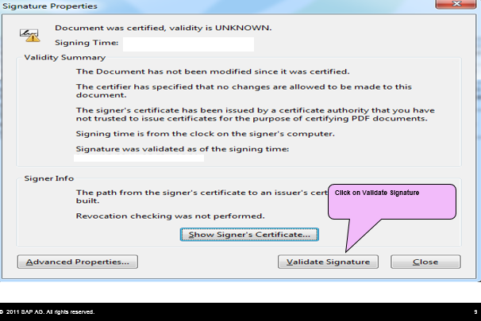
Signature Properties click Validate Signature radio button

Slide 11
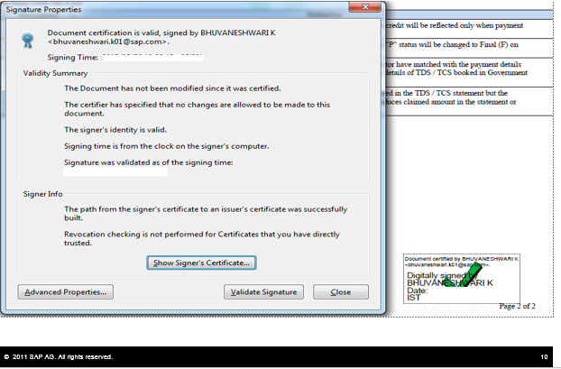
Finally Digital Signature will get Validated

Slide 12
> Thank You!

